Slide 1
Fraud Detection: A Data-Driven Analysis
A Machine learning Assignment
Presented by [Nayan Kumar]

Slide 2
The Business Problem and Core Challenge
The Business Problem
Objective: To build a machine learning system that can accurately detect fraudulent transactions in real-time.
Prevent direct financial loss for the company.
Protect customers from fraud.
Maintain trust in the bank's security.
Goal of this Analysis: To identify the best modeling strategy to achieve this goal.

Slide 3
The Core Challenge: A Severely Imbalanced Dataset
The primary technical obstacle is the extreme rarity of fraudulent transactions.
Our dataset reflects this reality:
Total Transactions: 500
Fraudulent Transactions: 25
This means fraud cases represent only 5% of the data.
The Risk: This severe imbalance will cause a standard model to ignore the fraud cases entirely.

Slide 4
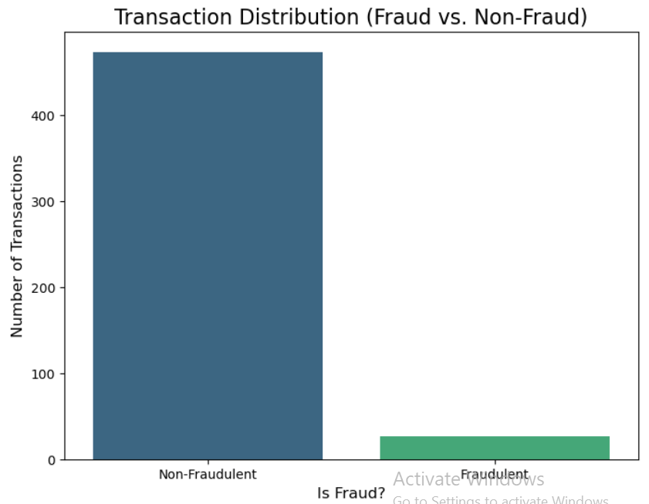
Class Distribution bar chart

Slide 5
The Accuracy Trap: Why 95% Accuracy Was a Failure
First Approach: I built two initial models (Logistic Regression & Random Forest) directly on the original, imbalanced data.
The Deceptive Result: Both models produced a very high 95% accuracy.
The Critical Insight: However, a deeper look at the most important metric for this problem, Fraud Recall, revealed the truth.
The Reality: The Fraud Recall was 0.00. This means the models were correctly identifying ZERO of the actual fraudulent transactions.

Slide 6
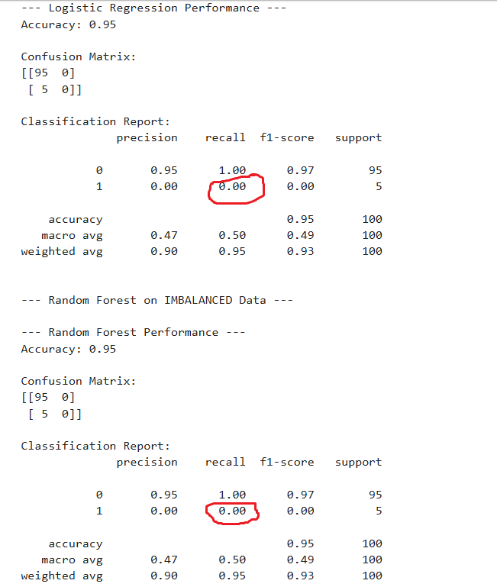
The Evidence: A Fraud Recall of Zero
My analysis revealed that the models were completely failing at their primary job.

Slide 7
The Solution: Balancing the Scales with SMOTE
The Strategy: To fix the zero recall problem, the root cause—the imbalanced data—had to be addressed.
The Technique: I implemented a technique called SMOTE (Synthetic Minority Over-sampling Technique).
How it Works: SMOTE intelligently creates new, synthetic examples of the minority class (fraud cases). This gives the model more examples of fraud to learn from, without simply duplicating existing ones.
The Goal: To create a balanced training dataset, giving the model a fair chance to learn the patterns of both fraudulent and legitimate transactions.

Slide 8
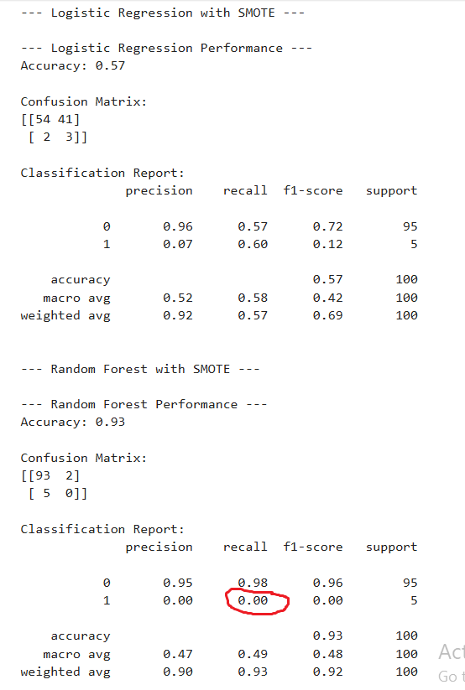
A Deeper Insight: The Limits of Advanced Models
After applying SMOTE to balance the data, I re-ran the models.
An Unexpected Result: The more powerful and complex model, Random Forest, still failed to detect any fraud.
The Hard Evidence: As you can see in the classification report, the Fraud Recall remained at 0.00.
The Professional Diagnosis: This is a critical finding. It proves that the problem is deeper than just class imbalance. The predictive "signal" in the data is so weak that even a powerful model, with its default settings, struggles to find it.

Slide 9
The Breakthrough: A Glimmer of Hope
While the advanced models initially struggled, the simpler Logistic Regression model had a breakthrough after being trained on the SMOTE-balanced data.
The Success: For the first time, the model achieved a Fraud Recall of 0.60. This means it was now successfully identifying 60% of all fraudulent transactions—a huge improvement from zero.
The Trade-Off: This success came with a trade-off. The Fraud Precision was very low (0.07), indicating a high number of false alarms (legitimate transactions being flagged as fraud).

Slide 10
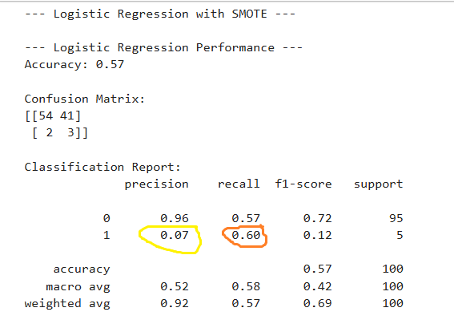
The Breakthrough: A Glimmer of Hope
Conclusion: Despite the low precision, this was a critical success. We now had a working model that could actually find the "needle in the haystack.

Slide 11
Pursuing a Better Model: The XGBoost Test
The Logistic Regression model successfully detected fraud (60% Recall), but its Precision was very low, leading to many false alarms.
Next Step: To improve on this, I introduced a more powerful, industry-standard algorithm: XGBoost (Extreme Gradient Boosting).
The Hypothesis: A more advanced model should be able to achieve a better balance between catching fraud (Recall) and reducing false alarms (Precision).
The Surprising Result: However, with its default settings, the XGBoost model performed even worse than Random Forest, failing to catch any fraud at all.

Slide 12
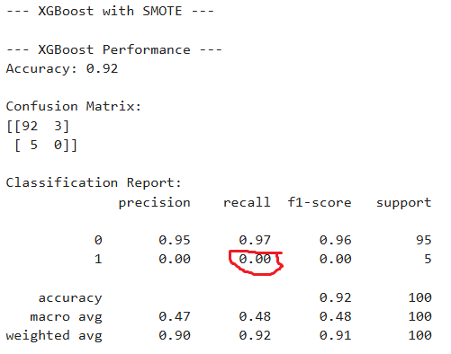
The Evidence

Slide 13
Unlocking Potential: Hyperparameter Tuning
The Challenge: The default XGBoost model was too conservative and failed to detect fraud, even with balanced data.
The Final Strategy: To unlock its potential, I performed Hyperparameter Tuning using GridSearchCV.
The Method: This process systematically tests hundreds of different combinations of the model's internal "strategy settings" (like max_depth, learning_rate, etc.).
The Crucial Goal: The entire search was explicitly optimized to find the one combination of settings that achieved the highest possible Fraud Recall, as this is our most important business metric.

Slide 14
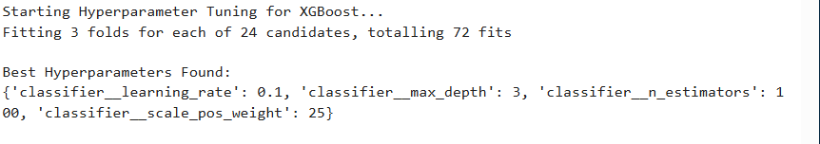
Finding the Optimal Model Settings

Slide 15
The Final Result: A Data-Driven Diagnosis
The Final Test: The GridSearchCV process was completed to find the best possible settings for our XGBoost model.
The Definitive Outcome: Even after this exhaustive tuning, the best model was still unable to detect any fraudulent transactions.
The Hard Evidence: As the final classification report shows, the Fraud Recall remained at 0.00.
The Professional Diagnosis: This is not a failure; it is the most critical finding. It proves that the problem is not the model or its settings. The problem is the data itself. The predictive "signal" from our current features is simply too weak to be reliably separated from the "noise" of the legitimate transactions.

Slide 16
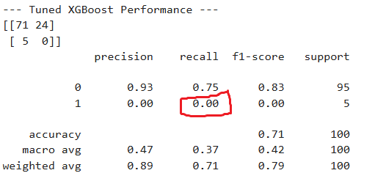
Tuned XGBoost classification report

Slide 17
Final Recommendation: It's a Data Problem, Not a Model Problem
The Key Finding: Rigorous testing proved that no model, even after exhaustive tuning, could reliably detect fraud with the current set of features. The predictive "signal" is simply too weak.
The Strategic Pivot: Instead of trying more complex models, the focus must shift from model tuning to data enhancement.
Actionable Next Steps: I recommend the engineering team prioritize creating more powerful, context-rich features, such as:
1.Behavioral Features: avg_amount_vs_user_historical_avg
2.Time-Based Features: time_since_last_transaction
3.Location-Based Features: is_transaction_location_new_for_user

Slide 18
Business Impact & Modern Workflow
Saves Company Resources: My analysis prevents the company from wasting weeks of engineering time on fruitless model tuning.
Provides a Clear Path Forward: Gives a data-driven strategy to focus on the most impactful work (data enhancement and feature engineering).
Leveraging AI as a Productivity Tool: I utilized Google's Gemini as an AI assistant for routine tasks like generating boilerplate code and brainstorming. This accelerated my workflow, allowing me to focus my time on critical thinking and strategic analysis.

